Slide 1
User interface design

Slide 2
Recap
OOD is an approach to design so that design components have their own private state and operations
Objects should have constructor and inspection operations. They provide services to other objects
Objects may be implemented sequentially or concurrently
The Unified Modeling Language provides different notations for defining different object models

Slide 3
Recap
A range of different models may be produced during an object-oriented design process. These include static and dynamic system models
Object interfaces should be defined precisely using e.g. a programming language like Java
Object-oriented design simplifies system evolution

Slide 4
Objectives
To suggest some general design principles for user interface design
To explain different interaction styles
To introduce styles of information presentation
To describe the user support which should be built-in to user interfaces
To introduce usability attributes and system approaches to system evaluation

Slide 5
Topics covered
User interface design principles
User interaction
Information presentation
User support
Interface evaluation

Slide 6
The user interface
System users often judge a system by its
interface rather than its functionality
A poorly designed interface can cause a user to
make catastrophic errors
Poor user interface design is the reason why so
many software systems are never used

Slide 7
Graphical user interfaces
Most users of business systems interact with these systems through graphical interfaces although, in some cases, legacy text-based interfaces are still used

Slide 8
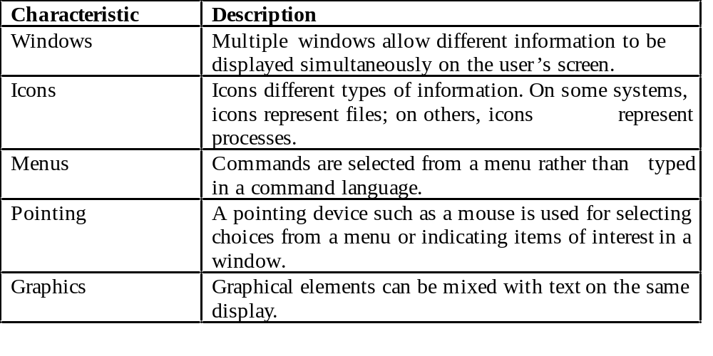
GUI characteristics

Slide 9
GUI advantages
They are easy to learn and use.
  Users without experience can learn to use the system
  quickly.
The user may switch quickly from one task to
another and can interact with several different applications.
  Information remains visible in its own window when
  attention is switched.
Fast, full-screen interaction is possible with immediate access to anywhere on the screen

Slide 10
User-centred design
The goal is to sensitise software engineers to key issues underlying the design rather than the implementation of user interfaces
User-centred design is an approach to UI design where the needs of the user are paramount and where the user is involved in the design process
UI design always involves the development of prototype interfaces

Slide 11
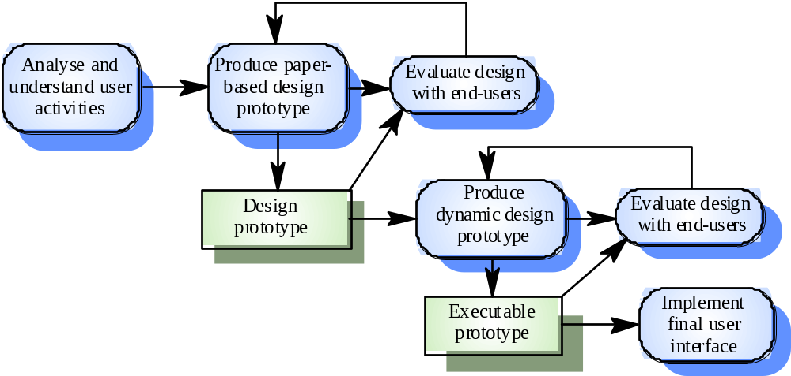
User interface design process

Slide 12
UI design principles
UI design must take account of the needs, experience and capabilities of the system users
Designers should be aware of people’s physical and mental limitations (e.g. limited short-term memory) and should recognise that people make mistakes
UI design principles underlie interface designs although not all principles are applicable to all designs

Slide 13
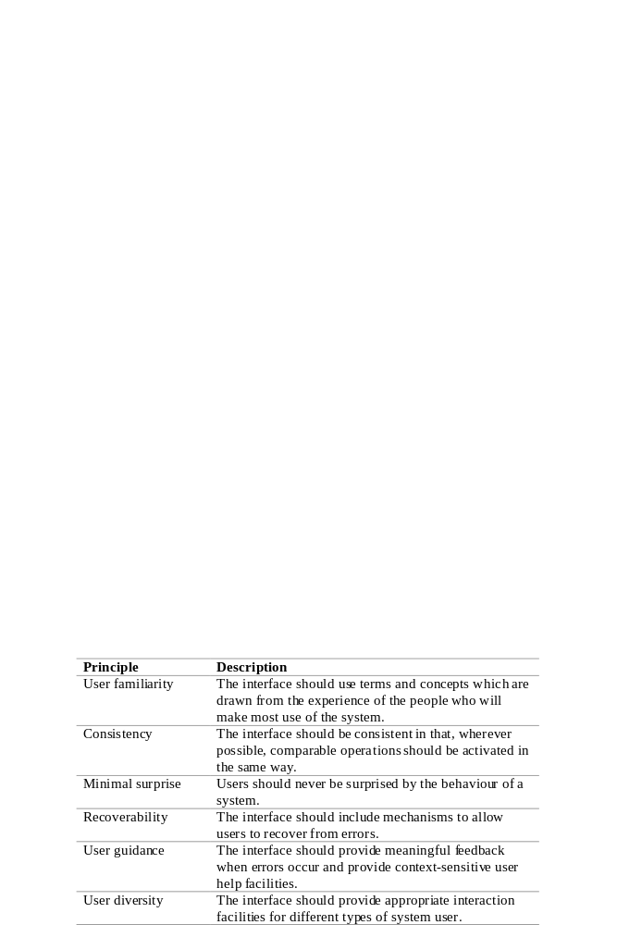
User interface design principles

Slide 14
Design principles
User familiarity
  The interface should be based on user-oriented
  terms and concepts rather than computer concepts. For example, an office system should use concepts such as letters, documents, folders etc. rather than directories, file identifiers, etc.
Consistency
  The system should display an appropriate level
  of consistency. Commands and menus should have the same format, command punctuation should be similar, etc.
Minimal surprise
  If a command operates in a known way, the user should be
  able to predict the operation of comparable commands

Slide 15
Design principles
Recoverability
  The system should provide some resilience to
  user errors and allow the user to recover from errors. This might include an undo facility, confirmation of destructive actions, 'soft' deletes, etc.
User guidance
  Some user guidance such as help systems, on-line manuals, etc. should be supplied
User diversity
  Interaction facilities for different types of user should be supported. For example, some users have seeing difficulties and so larger text should be available

Slide 16
User-system interaction
Two problems must be addressed in interactive systems design
  How should information from the user be provided to the computer system?
  How should information from the computer system be presented to the user?
User interaction and information presentation may be integrated through a coherent framework such as a user interface metaphor

Slide 17
Interaction styles
Direct manipulation
Menu selection
Form fill-in
Command language
Natural language

Slide 18
Direct manipulation advantages
Users feel in control of the computer and are less likely to be intimidated by it
User learning time is relatively short
Users get immediate feedback on their actions
so mistakes can be quickly detected and
corrected

Slide 19
Direct manipulation problems
The derivation of an appropriate information
space model can be very difficult
Given that users have a large information
space, what facilities for navigating around that space should be provided?
Direct manipulation interfaces can be complex to program and make heavy demands on the computer system

Slide 20
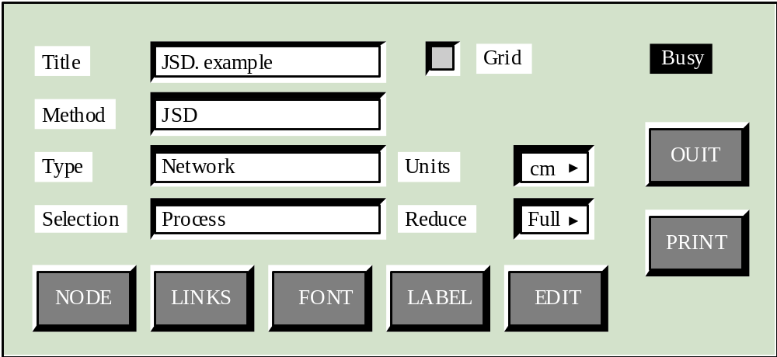
Control panel interface

Slide 21
Menu systems
Users make a selection from a list of
possibilities presented to them by the system
The selection may be made by pointing and
clicking with a mouse, using cursor keys or by
typing the name of the selection
May make use of simple-to-use terminals such as touchscreens

Slide 22
Advantages of menu systems
Users need not remember command names as they are always presented with a list of valid commands
Typing effort is minimal
User errors are trapped by the interface
Context-dependent help can be provided. The user’s context is indicated by the current menu selection

Slide 23
Problems with menu systems
Actions which involve logical conjunction (and)
or disjunction (or) are awkward to represent
Menu systems are best suited to presenting a
small number of choices. If there are many
choices, some menu structuring facility must be
used
Experienced users find menus slower than
command language

Slide 24
Command interfaces
User types commands to give instructions to the system e.g. UNIX
May be implemented using cheap terminals.
Easy to process using compiler techniques
Commands of arbitrary complexity can be
created by command combination
Concise interfaces requiring minimal typing can
be created

Slide 25
Problems with command interfaces
Users have to learn and remember a command
language. Command interfaces are therefore
unsuitable for occasional users
Users make errors in command. An error
detection and recovery system is required
System interaction is through a keyboard so
typing ability is required

Slide 26
Command languages
Often preferred by experienced users because they allow for faster interaction with the system
Not suitable for casual or inexperienced users
May be provided as an alternative to menu commands (keyboard shortcuts). In some cases, a command language interface and a menu-based interface are supported at the same time

Slide 27
Natural language interfaces
The user types a command in a natural language. Generally, the vocabulary is limited and these systems are confined to specific application domains (e.g. timetable enquiries)
NL processing technology is now good enough to make these interfaces effective for casual users but experienced users find that they require too much typing

Slide 28
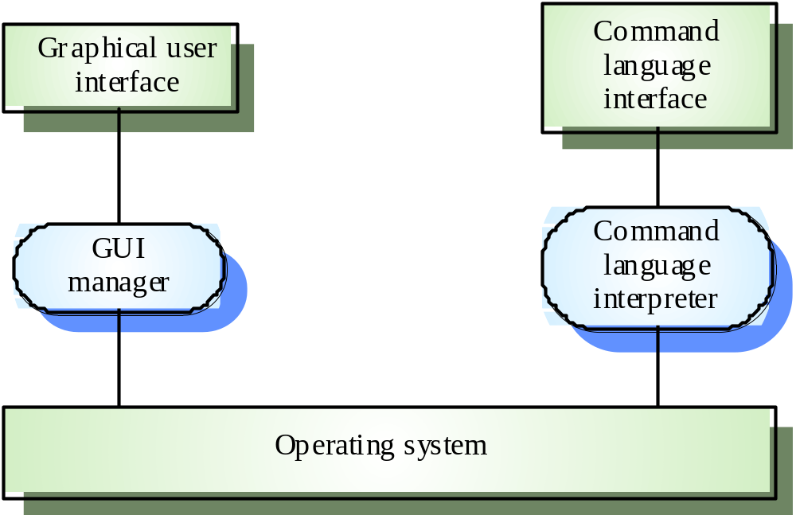
Multiple user interfaces

Slide 29
Information presentation
Information presentation is concerned with presenting system information to system users
The information may be presented directly (e.g. text in a word processor) or may be transformed in some way for presentation (e.g. in some graphical form)

Slide 30
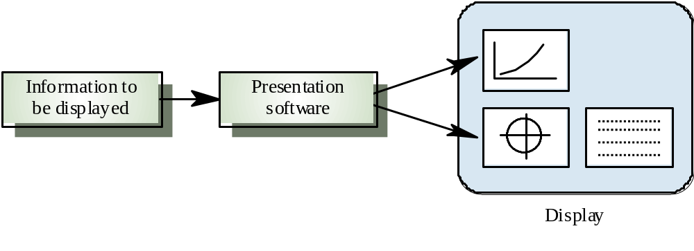
Information presentation

Slide 31
Summary
User Interface
GUI Characteristics (Windows, Icons, Menus, Pointing, Graphics)
User Centered Design
User Interface Design Process
UI Design Principles
  User familiarity
  Consistency
  Minimal Surprise
  Recoverability
  User guidance
  User diversity
User System Interaction
  How users will interact with the software?
  How software will present information to the user?

Slide 32
Reference
Ian Sommerville, Software Engineering, Chapter 13, 6th Edition

